Slide 1

Stop Phishing Scam Email
tips for a simpler way to work
18171 Natalia

Slide 2
Phishing
Phishing is the fraudulent use of electronic communications to deceive and take advantage of users.
Phishing attacks attempt to gain sensitive, confidential information such as usernames, passwords, credit card information, network credentials, and more.
By posing as a legitimate individual or institution via phone or email, cyber attackers use social engineering to manipulate victims into performing specific actions—like clicking on a malicious link or attachment—or wilfully divulging confidential information.
Both individuals and organizations are at risk; almost any kind of personal or organizational data can be valuable, whether it be to commit fraud or access an organization’s network. In addition, some phishing scams can target organizational data in order to support espionage efforts or state-backed spying on opposition groups.

Slide 3
Phishing Methods
• Through link manipulation, an email may present with links that spoof legitimate URLs; manipulated links may feature subtle misspellings or use of a subdomain.
• Phishing scams may use website forgery, which employs JavaScript commands to make a website URL look legitimate.
• Using covert redirection, attackers can corrupt legitimate websites with malicious pop-up dialogue boxes that redirect users to a phishing website.
• Infected attachments, such as .exe files, Microsoft Office files, and PDF documents can install ransomware or other malware.
Phishing attempts most often begin with an email attempting to obtain sensitive information through some user interaction, such as clicking on a malicious link or downloading an infected attachment.
Phishing scams can also employ phone calls, text messages, and social media tools to trick victims into providing sensitive information.

Slide 4
Types of Phishing Attacks
Some specific types of phishing scams use more targeted methods to attack certain individuals or organizations.
Email phishing
Scammers create emails that impersonate legitimate companies and attempt to steal your information. This is the type that the company Heaven Systems is having issues with.
Spear Fishing
Spear phishing email messages won’t look as random as more general phishing attempts. Attackers will often gather information about their targets to fill emails with more authentic context. Some attackers even hijack business email communications and create highly customized messages.

Slide 5
Types of Phishing Attacks
Clone Phishing
Attackers are able to view legitimate, previously delivered email messages, make a nearly identical copy of it—or “clone”—and then change an attachment or link to something malicious.
Whaling
Whaling specifically targets high profile and/or senior executives in an organization. The content of a whaling attempt will often present as a legal communication or other high-level executive business.
Pop-up phishing
Fraudulent pop-ups trick users into installing malware.

Slide 6
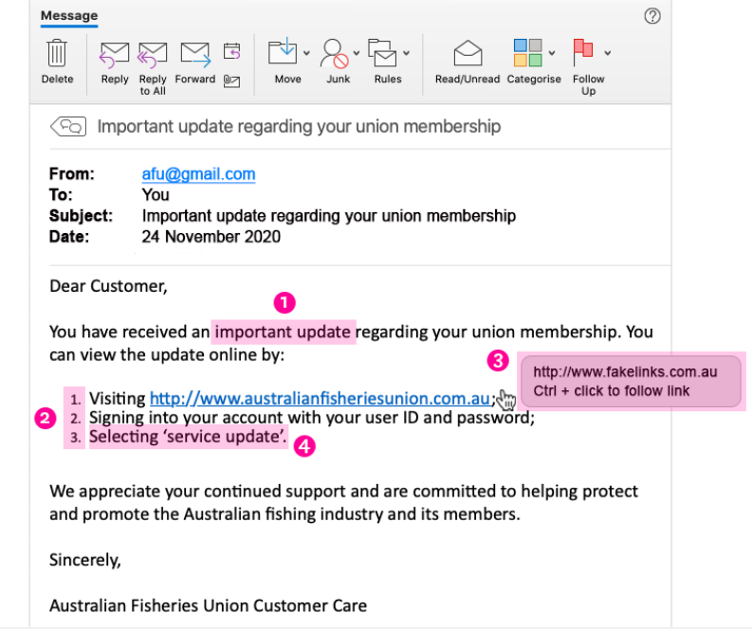
When you see your email like:

Slide 7
Phishing emails
1
It is unexpected or creates a sense of urgency for you to do something – This might be by sending you an email that is unexpected so you don’t know how to react (e.g. telling you that you have received a missed call and sending you to a website to hear it) or by creating a sense of urgency so that you don’t have time to think about how to react (e.g. telling you that one of your accounts is about to be terminated unless you act quickly). In the example above, the scammer uses the wording ‘important update’ to create a sense of urgency for you to click on the link they have provided.

Slide 8
Phishing emails
2
It asks you to click a link, open an attachment or sends you to a website which asks you to enter your information – For the phishing attempt to be successful, the scammer needs you to perform an action. In the example above, the scammer asks recipients to click on a link and enter their union username and password combination.

Slide 9
Phishing emails
3
The link suggests that it will take you to a legitimate website but, when you hover over the link, it shows that it is actually for a different website – In the example above, the link appears legitimate, sending recipients to australianfisheriesunion.com.au.
However, recipients who hover over the link will see that if they click on it, it will actually send them to a different website at www.fakelinks.com.au.

Slide 10
Phishing emails
4
It asks for information that the real or legitimate sender would not necessarily need to know – In the example above, the scammer would send the recipient to a fake website where they would ask them to enter their real username and password combination that the recipient uses for their union membership.
Choose a design you like from the Design Ideas task pane.

Slide 11
How to Prevent Phishing Attacks
Organizations should educate employees to prevent phishing attacks, particularly how to recognize suspicious emails, links, and attachments. Cyber attackers are always refining their techniques, so continued education is imperative.
Some tell-tale signs of a phishing email include:
• ‘Too good to be true’ offers
• Unusual sender
• Poor spelling and grammar
• Threats of account shutdown, etc., particularly conveying a sense of urgency
• Links, especially when the destination URL is different than it appears in the email content
• Unexpected attachments, especially .exe files

Slide 12
How to Prevent Phishing Attacks
Additional technical security measures can include:
• Two Factor Authentication incorporating two methods of identity confirmation—something you know (i.e., password) and something you have (i.e., smartphone)
• Email filters that use machine learning and natural language processing to flag high-risk email messages. DMARC protocol can also prevent against email spoofing.
• Augmented password logins using personal images, identity cues, security skins, etc.
• Check emails legitimacy by contacting the relevant business or organisation (using contact details sourced from the official company website).

Slide 13
How to Prevent Phishing Attacks
• Before you click a link (in an email or on social media, instant messages, other web pages, or other means), hover over that link to see the actual web address it will take you to (usually shown at the bottom of the browser window). If you do not recognise or trust the address, try searching for relevant key terms in a web browser. This way you can find the article, video or web page without directly clicking on the suspicious link.
• Stay informed on the latest threats
• Do not open any email if you do not clear where it came from.
• Take time to confirm the relevant company email or web site address.
• Call or email follow the office site info to confirm true or false.

Slide 14
WHAT STEPS CAN ORGANISATIONS TAKE TO PROTECT AGAINST PHISHING ATTACKS?
1
2
Include security awareness in your organisation’s culture.
By raising awareness of the signs and dangers of phishing attacks, employees will be able to identify them; be less likely to fall for them; or at least be able to flag an issue and report it to you so you can take timely steps to contain the incident.
Use spam filters or secure email gateways to block deceptive emails from reaching employees.
Spam filters and secure email gateways monitor incoming emails for unwanted or fraudulent content. Once identified, they prevent them from ever reaching a employee’s inbox.

Slide 15
WHAT STEPS CAN ORGANISATIONS TAKE TO PROTECT AGAINST PHISHING ATTACKS?
3
Enable multifactor authentication (MFA) and anomaly login policies.
Even if an employee provides information to a scammer, these measures decrease a scammer’s ability to gain access to the employee’s work account and increase your ability to detect and respond to incidents in a timely manner.
Report phishing attempts
You should report phishing attempts the IT department. You can also report it to bigger authorities like to the Victorian Government Cyber Incident Response Service by emailing cybersecurity@dpc.vic.gov.au who can help you respond to the incident. You should also report security incidents to OVIC by emailing a copy of our incident notification form to incidents@ovic.vic.gov.au or contacting us at privacy@ovic.vic.gov.au for privacy advice.
4

Slide 16
WHAT STEPS CAN EMPLOYEES TAKE TO PROTECT AGAINST PHISHING ATTACKS?
1
Watch out for fake links or attachments.
Where you suspect an email to be a phishing attempt, contact your IT team. Do not open any attachments, click any links or forward the email to another device.
Do not provide information to unverified sources.
If you are unsure about whether you should be providing your information, check with your Privacy Officer or IT team. If the email is from someone familiar but the contents appears surprising or suspicious, contact them on the phone number you already hold to verify if they actually sent it.
If you receive a phishing email, notify your IT department.
If you think you have fallen for a phishing attempt or notice suspicious activity on your device, immediately disconnect from the internet and notify your IT team. Do not shut down or restart your device.
2
3

